Slide 1
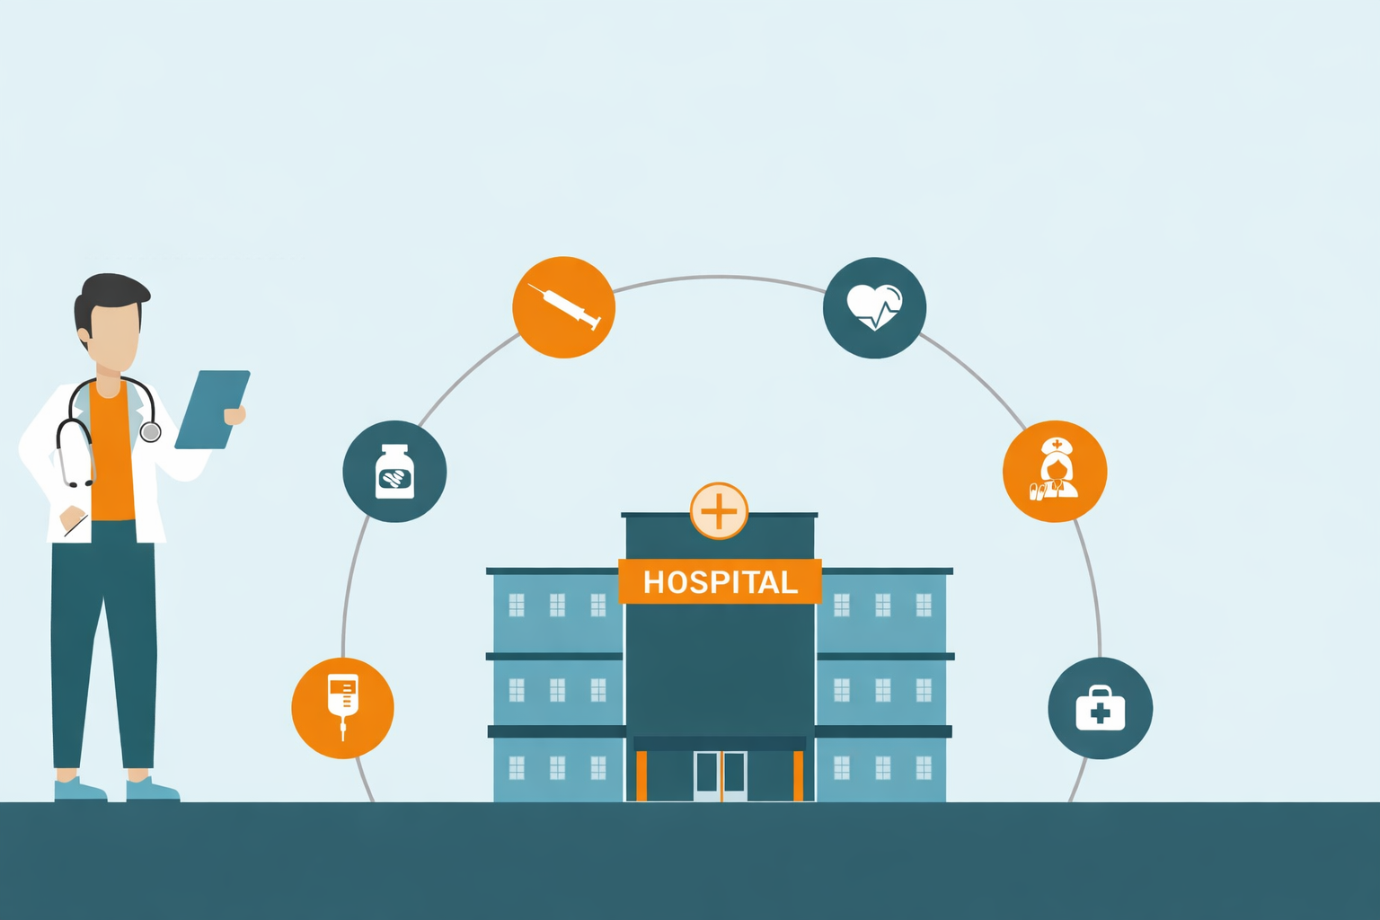
KPI Analysis of Lowell General Hospital

Slide 2
Problem Statement and objective
Problem Statement:
Lowell General Hospital focuses on improving patient safety, operational efficiency, and overall patient satisfaction. Monitoring key hospital performance metrics is essential to identify trends, evaluate service quality, and ensure effective healthcare management.
A structured KPI analysis helps uncover performance gaps and supports data-driven decision making to enhance patient experience.
Project Objectives:
Evaluate how hospital KPIs impact patient satisfaction and safety
Identify relationships and correlations between different KPIs
Benchmark hospital performance to identify areas of improvement
Provide data-driven recommendations to improve healthcare services

Slide 3
Dataset Overview
Data Source:
Lowell General Hospital Healthcare Dataset
Dataset Size:
60 Records × 4 Variables
Time Period:
January 2020 – December 2024
Key Variables:
Month – Time period of KPI measurement
Average Licensed Bed Occupancy Rate – Percentage of hospital beds occupied
Unassisted Fall Rate per 1,000 Patient Days – Number of patient falls occurring without staff assistance
Staff Responsiveness Domain Top Box Score – Percentage of patients reporting timely staff response

Slide 4
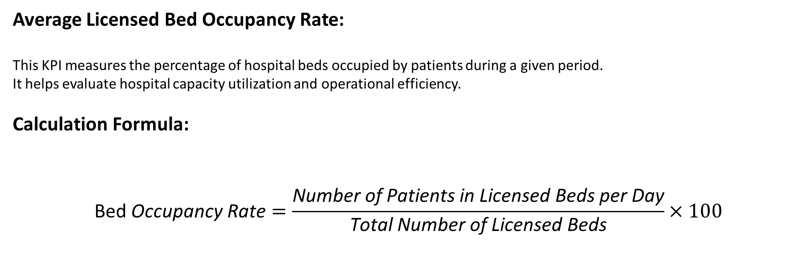
Understanding KPIs
Average Licensed Bed Occupancy Rate:
This KPI measures the percentage of hospital beds occupied by patients during a given period. It helps evaluate hospital capacity utilization and operational efficiency.
Calculation Formula:
$$\text{Bed} \text{Occupancy} \text{Rate}=\frac{\text{Number} \text{of} \text{Patients} \text{in} \text{Licensed} \text{Beds} \text{per} \text{Day}}{\text{Total} \text{Number} \text{of} \text{Licensed} \text{Beds}}×100$$

Slide 5
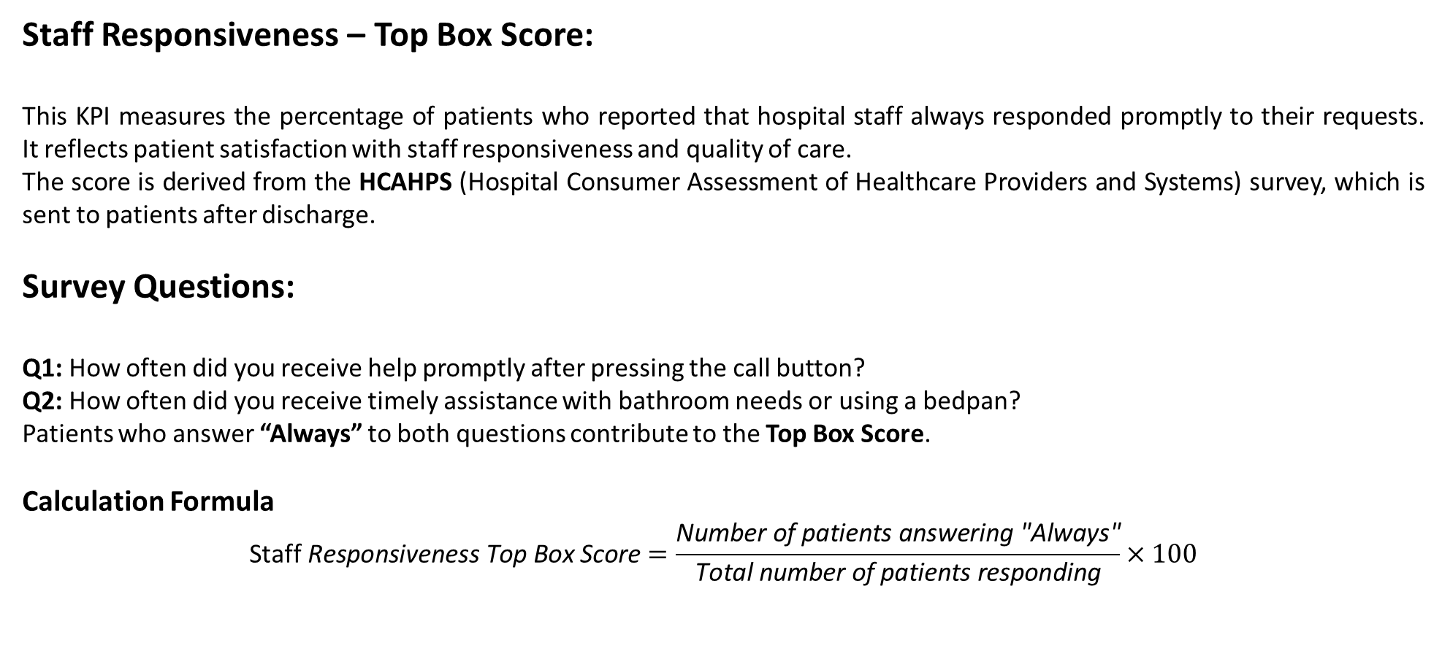
Understanding KPIs
Staff Responsiveness – Top Box Score:
This KPI measures the percentage of patients who reported that hospital staff always responded promptly to their requests. It reflects patient satisfaction with staff responsiveness and quality of care.
The score is derived from the HCAHPS (Hospital Consumer Assessment of Healthcare Providers and Systems) survey, which is sent to patients after discharge.
Survey Questions:
Q1: How often did you receive help promptly after pressing the call button?
Q2: How often did you receive timely assistance with bathroom needs or using a bedpan?
Patients who answer “Always” to both questions contribute to the Top Box Score.
Calculation Formula
$$\text{Staff} \text{Responsiveness} \text{Top} \text{Box} \text{Score}=\frac{\text{Number} \text{of} \text{patients} \text{answering}\text{ "}\text{Always}\text{"}}{\text{Total} \text{number} \text{of} \text{patients} \text{responding}}×100$$

Slide 6
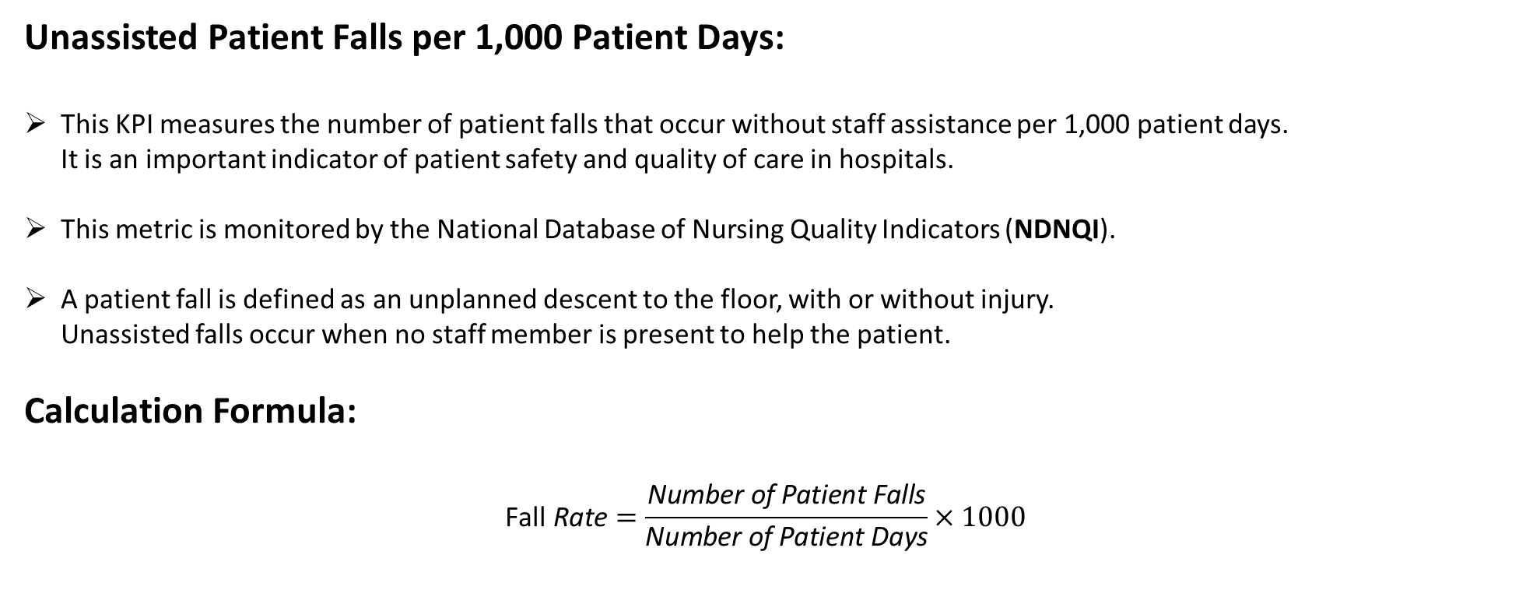
Understanding KPIs
Unassisted Patient Falls per 1,000 Patient Days:
This KPI measures the number of patient falls that occur without staff assistance per 1,000 patient days. It is an important indicator of patient safety and quality of care in hospitals.
This metric is monitored by the National Database of Nursing Quality Indicators (NDNQI).
A patient fall is defined as an unplanned descent to the floor, with or without injury. Unassisted falls occur when no staff member is present to help the patient.
Calculation Formula:
$$\text{Fall} \text{Rate}=\frac{\text{Number} \text{of} \text{Patient} \text{Falls}}{\text{Number} \text{of} \text{Patient} \text{Days}}×1000$$

Slide 7
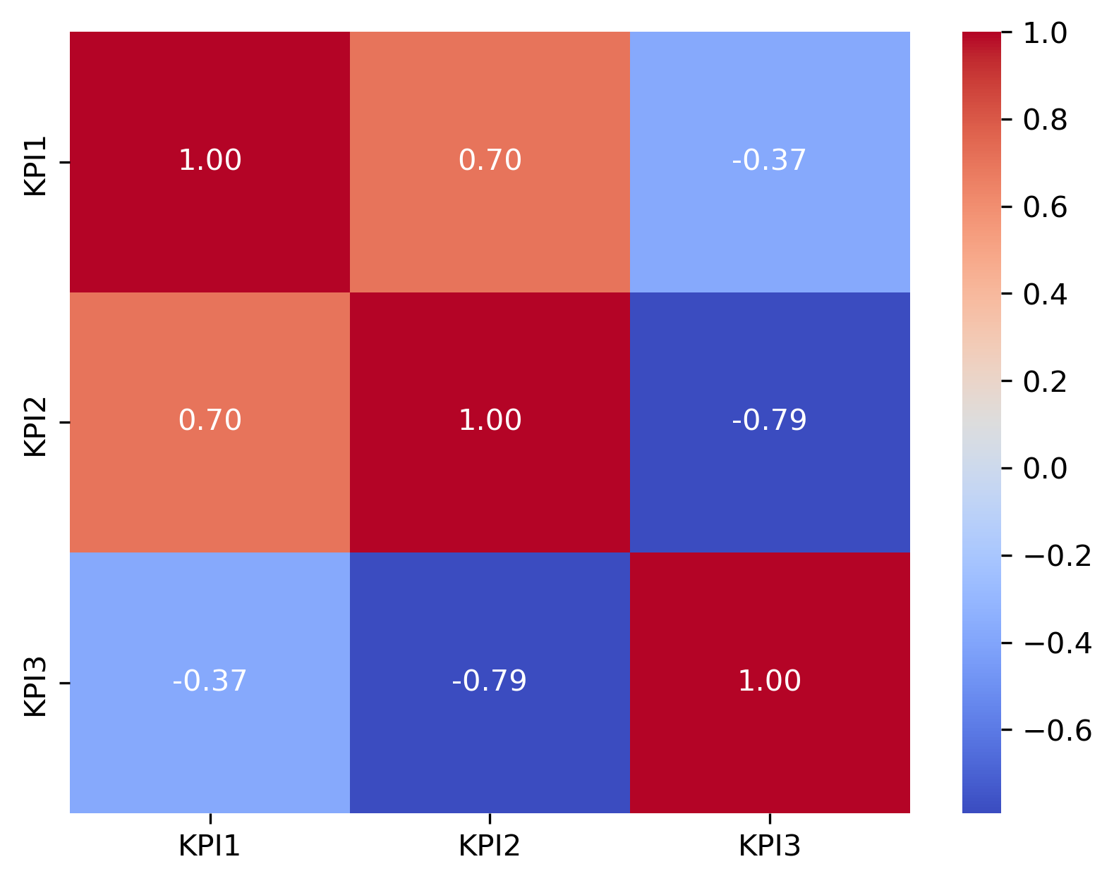
Relationship between the KPIs
Heatmap of Correlations between KPIs
Bed Occupancy Rate vs Fall Rate per 1000 Patient days Correlation: 0.70 (Strong Positive Relationship)
Bed Occupancy Rate vs Staff Responsiveness Correlation: -0.37 (Moderate Negative Relationship)
Fall Rate per 1000 Patient days vs Staff Responsiveness Correlation: -0.79 (Strong Negative Relationship)

Slide 8
Relationship between the KPIs
Bed Occupancy Rate & Fall Rate per 1,000 Patient Days – 0.70 (Strong positive correlation)
As the bed occupancy rate increases, the unassisted fall rate tends to increase as well.
Interpretation: Higher bed occupancy (more patients in the hospital) might lead to increased pressure on hospital staff, which could result in a higher fall rate. This suggests a possible need for more efficient staffing or patient monitoring as occupancy increases.

Slide 9
Relationship between the KPIs
Bed Occupancy Rate & Staff Responsiveness Score – (-0.37 ) (Moderate negative correlation)
As bed occupancy increases, staff responsiveness tends to decrease slightly.
Interpretation: Higher occupancy may cause more strain on hospital staff, potentially affecting their ability to be as responsive to patient needs. This could point to a need for better resource management or training in high-demand situations.

Slide 10
Relationship between the KPIs
Fall Rate per 1,000 Patient Days & Staff Responsiveness Score – (-0.79) (Strong negative correlation)
As staff responsiveness improves (higher score), the fall rate tends to decrease.
Interpretation: Better staff responsiveness is strongly linked to fewer falls, which makes sense—responsive staff are likely to be more proactive in ensuring patient safety and preventing falls.

Slide 11
Relationship between the KPIs
Summary of Relationships between the KPIs:
Higher bed occupancy is associated with higher fall rates and slightly lower staff responsiveness. Hospitals may need to ensure that higher occupancy does not overwhelm staff, potentially compromising patient safety and care. Better staff responsiveness is strongly associated with fewer falls, indicating that when staff are more responsive, patient safety improves, and falls are reduced.

Slide 12
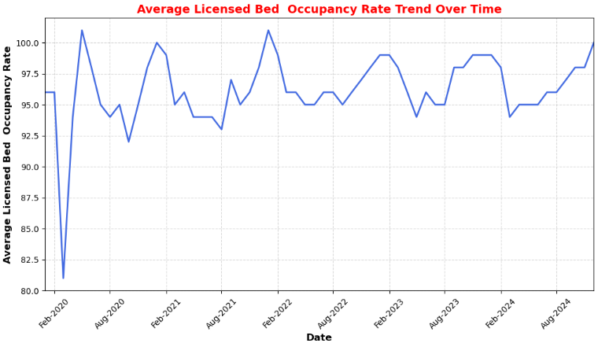
Bed occupancy remained consistently above 94%, indicating high hospital capacity utilization.
From 2021 onwards, occupancy stabilized and remained consistently high, reflecting strong patient demand.

Slide 13
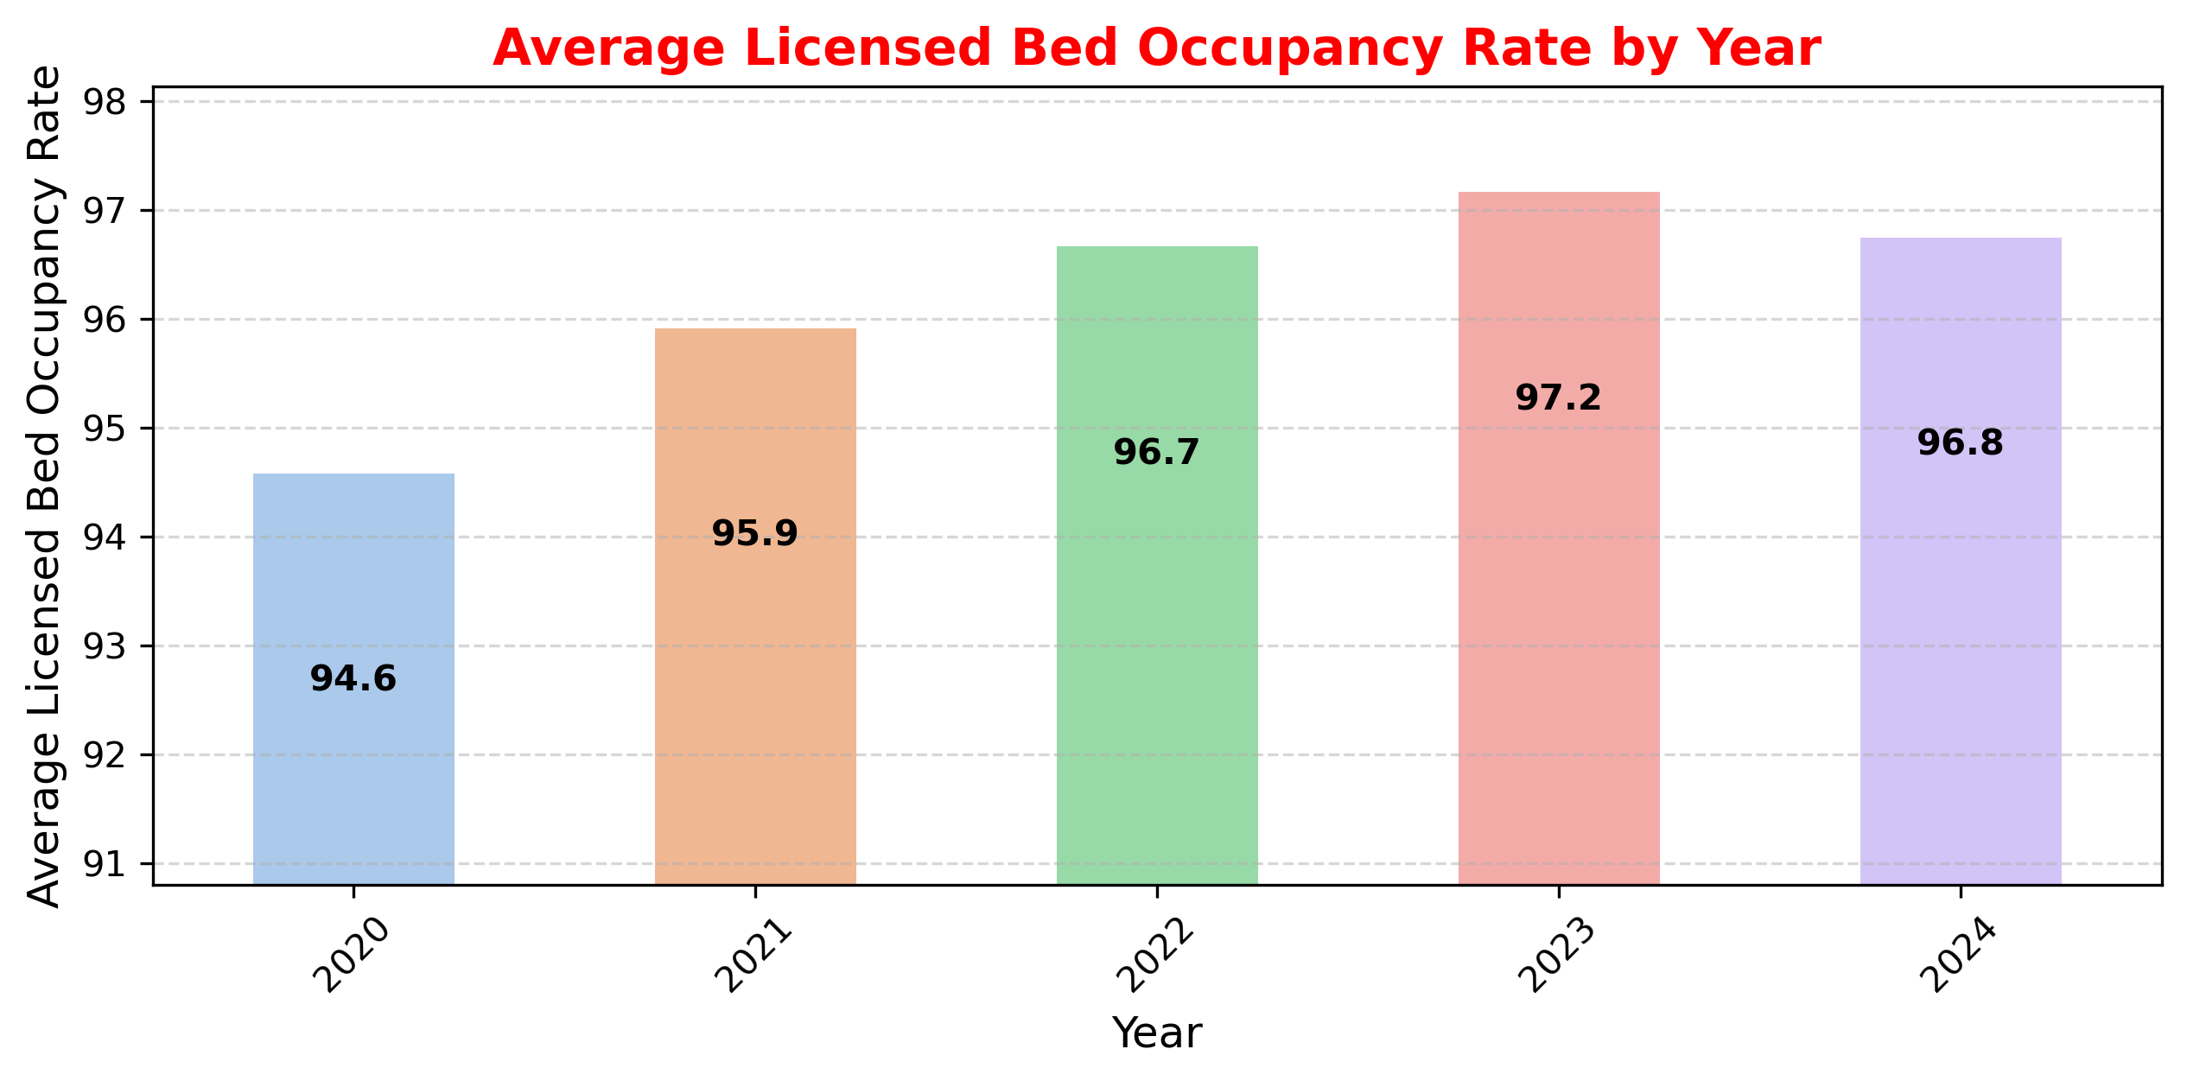
Bed occupancy increased from 94.6% in 2020 to 97.2% in 2023, showing growing hospital utilization.
2023 recorded the highest occupancy, indicating peak patient demand.
Occupancy slightly declined in 2024 (96.8%) but remained consistently high.

Slide 14
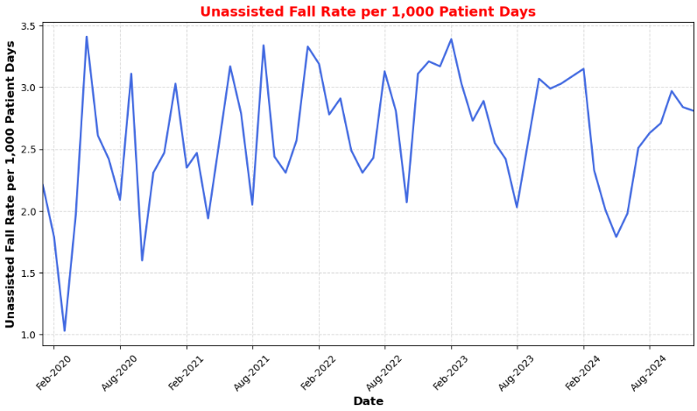
The fall rate fluctuates between ~2.0 and 3.4 per 1,000 patient days, indicating variability in patient safety outcomes.
Several spikes are observed between 2021 and 2023, suggesting periods of increased fall risk.
A noticeable decline appears in early 2024, indicating potential improvements in fall prevention measures.

Slide 15
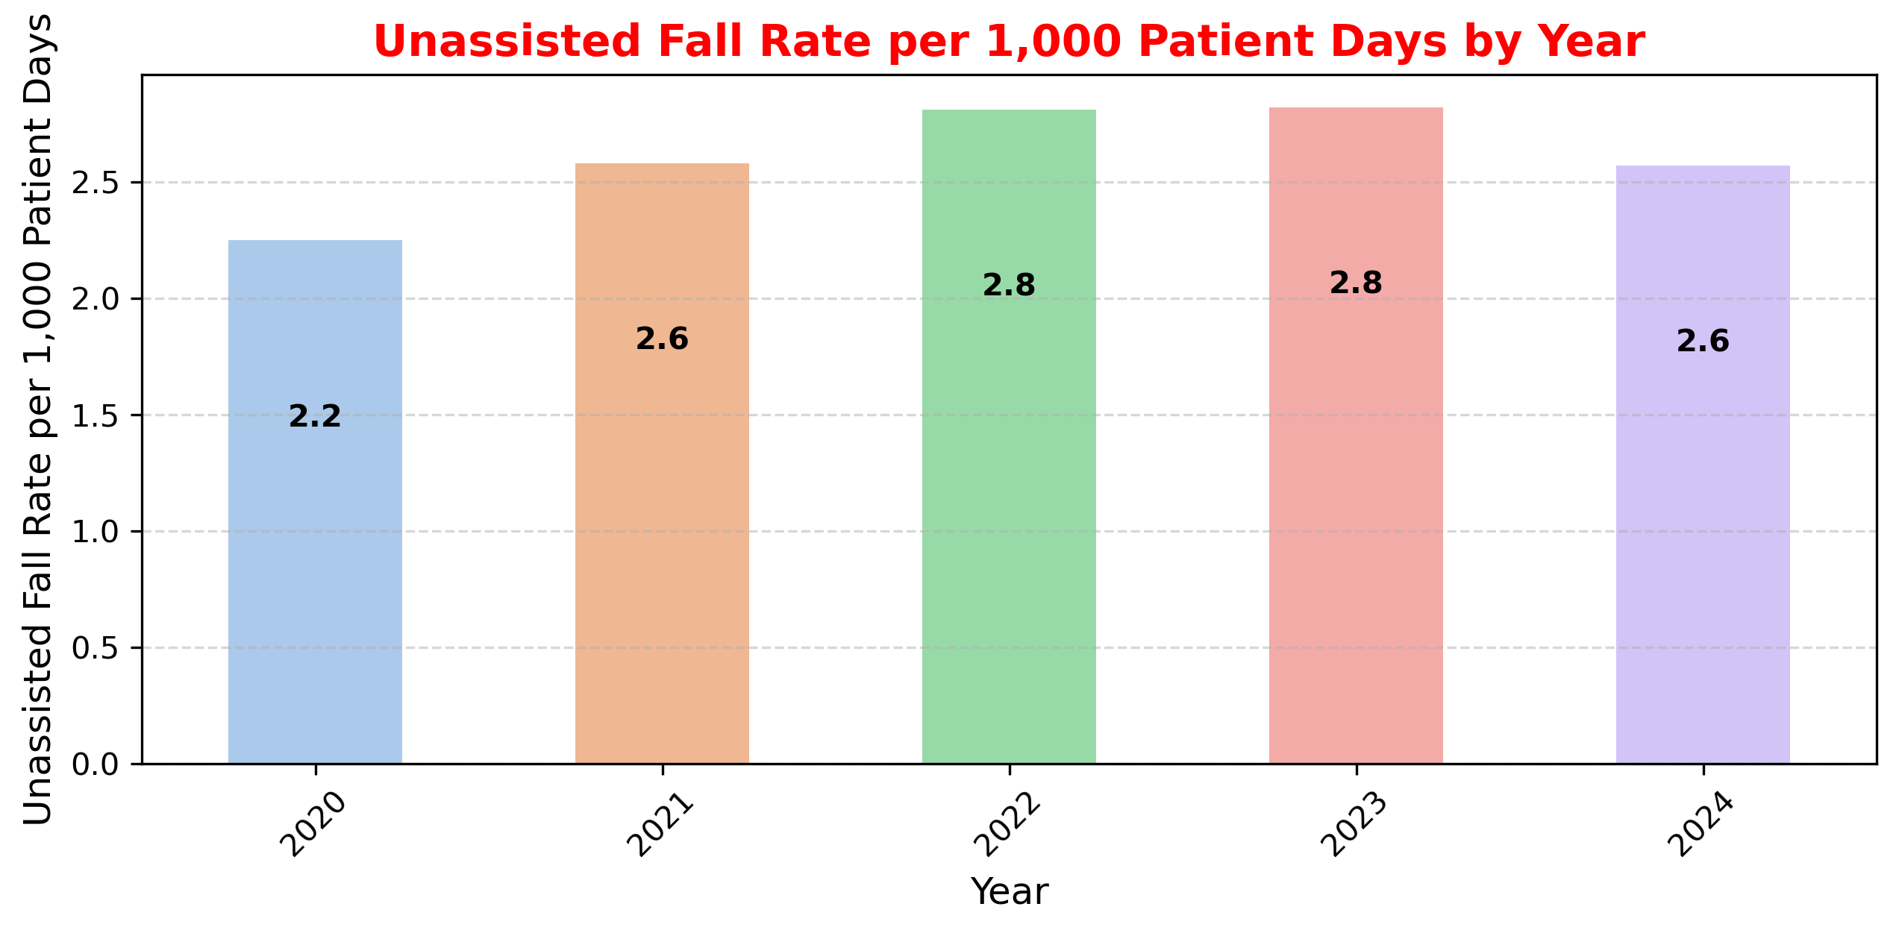
The fall rate increased from 2.2 in 2020 to 2.8 in 2022–2023, indicating a rise in patient fall incidents.
2022 and 2023 recorded the highest fall rates, highlighting potential safety concerns during these years.
The fall rate decreased slightly in 2024 (2.6), suggesting possible improvements in patient safety initiatives.

Slide 16
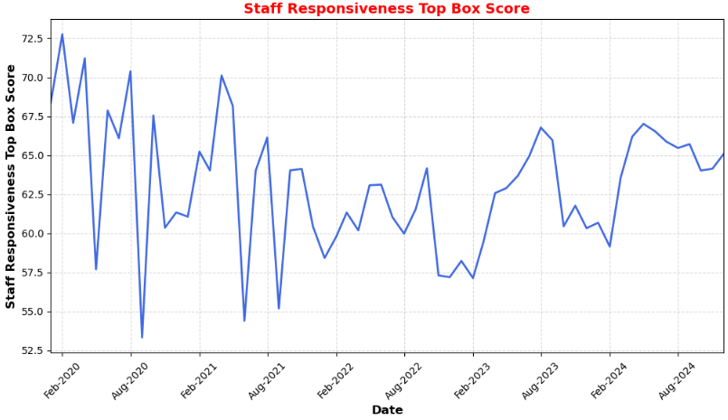
Staff responsiveness scores fluctuate between ~55 and 73, indicating variability in patient experience over time.
A noticeable decline occurs between 2021 and 2022, suggesting potential operational challenges during that period.
Scores show gradual improvement after 2023, indicating better staff responsiveness and service quality.

Slide 17
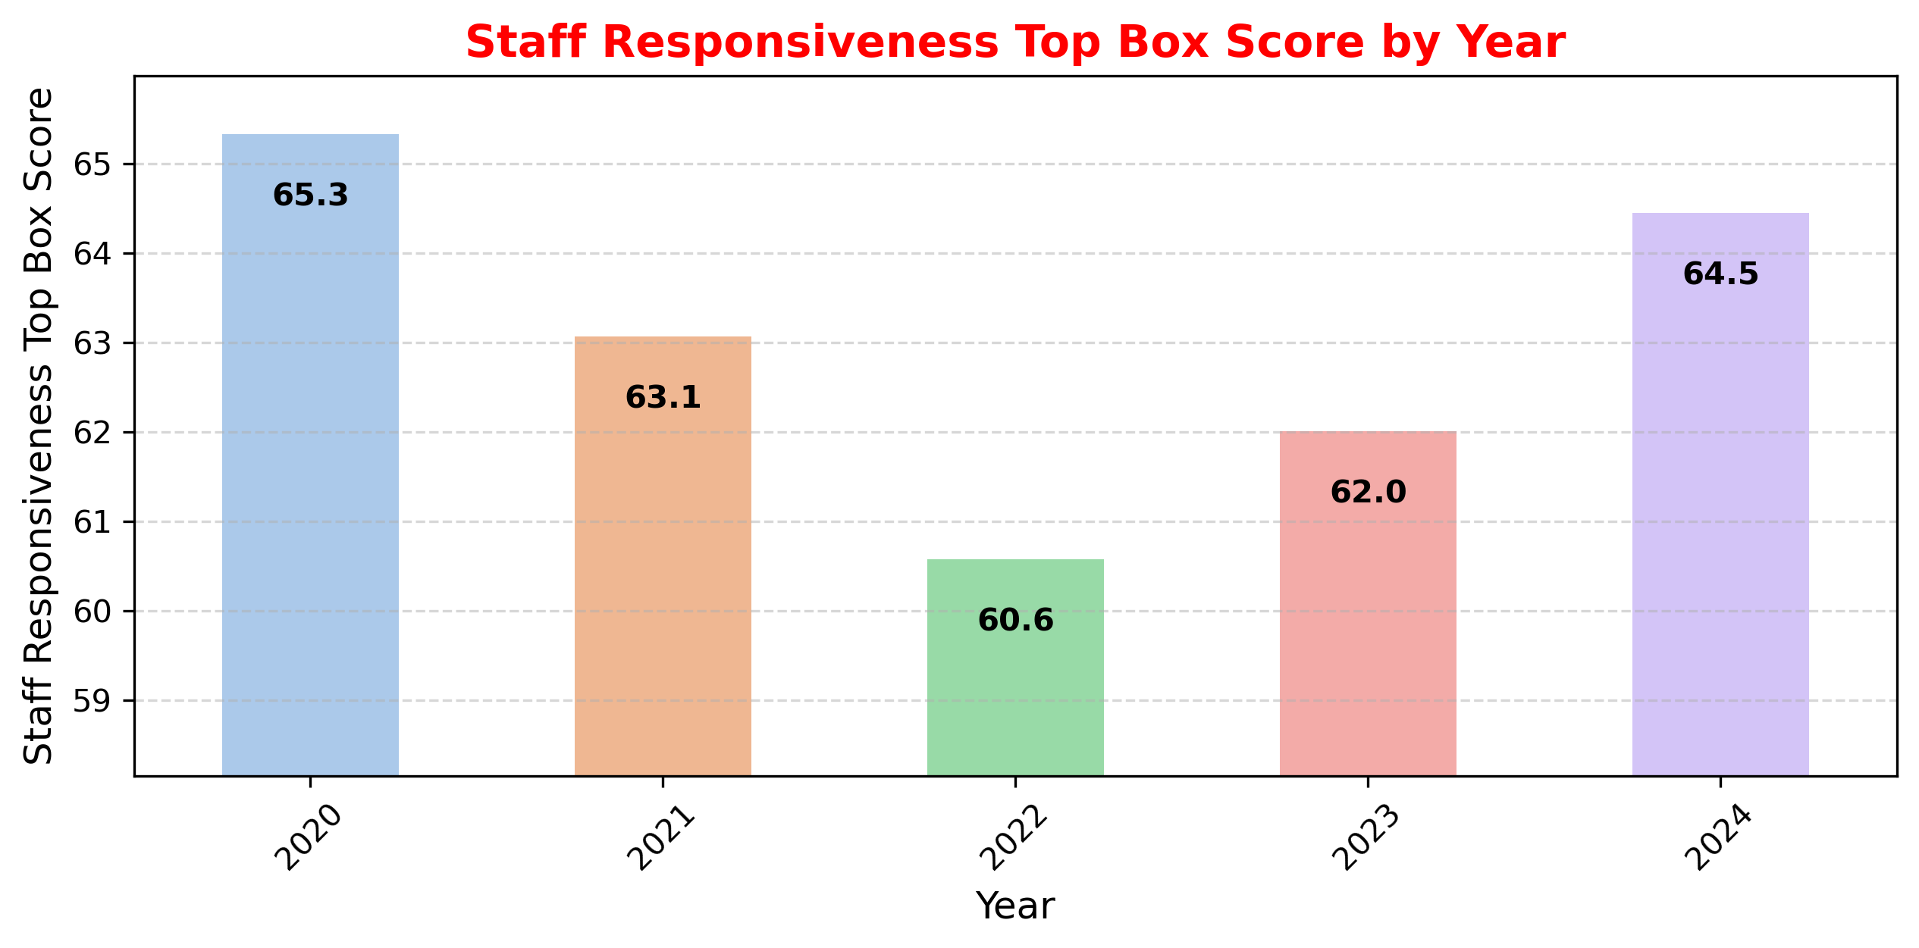
The average responsiveness score declined from 65.3 in 2020 to 60.6 in 2022, indicating reduced patient satisfaction during this period.
2022 recorded the lowest score, highlighting potential challenges in staff responsiveness.
The score improved again in 2023 and 2024, suggesting recovery in service quality.

Slide 18
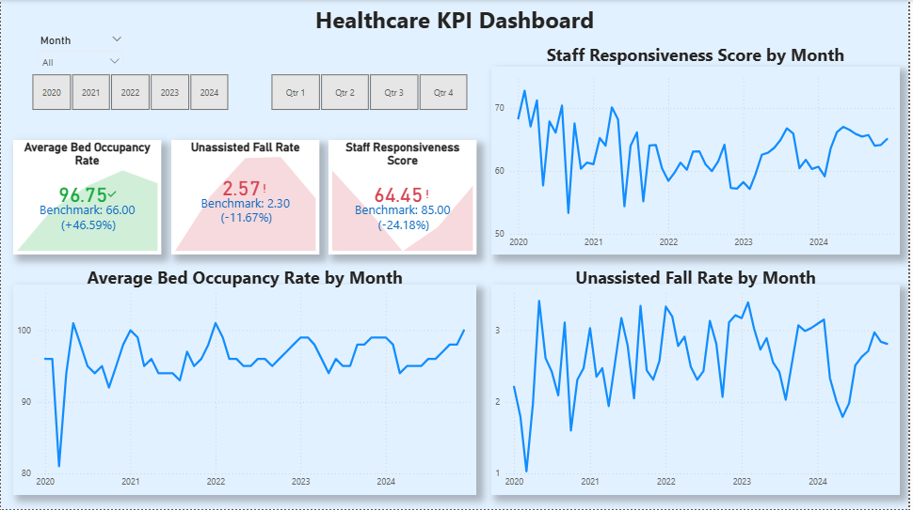

Slide 19
Bed Occupancy Benchmark Comparison
Comparison:
Lowell General Hospital: 96.2% U.S. Hospital Average: ~66%
Insights:
Lowell General Hospital operates at a much higher occupancy level than the national average.
This suggests strong patient demand and efficient bed utilization.
However, occupancy levels above 85% may create operational pressure, potentially impacting staff workload and patient satisfaction.

Slide 20
Patient Fall Rate Benchmark Comparison
Comparison:
Lowell General Hospital: 2.61 falls per 1,000 patient days U.S. Benchmark Range: 2.3 – 13 falls per 1,000 patient days
Insights:
The hospital's fall rate is toward the lower end of the national benchmark range.
This suggests effective patient safety practices and fall prevention protocols.
However, continuous monitoring is important, especially during periods of high bed occupancy.

Slide 21
Staff Responsiveness Benchmark Comparison
Comparison:
Lowell General Hospital: 63.1% Industry Benchmark: 85% – 90%
Insights:
Staff responsiveness at the hospital is below the industry benchmark.
Lower responsiveness may indicate delays in addressing patient needs.
High bed occupancy levels may increase staff workload, affecting response times.

Slide 22
Final Assessment
Key Findings:
High bed occupancy combined with lower staff responsiveness suggests operational pressure on hospital resources.
Despite high occupancy levels, patient fall rates remain relatively low, indicating effective fall prevention practices.
Improving staff responsiveness could enhance patient safety, satisfaction, and overall hospital performance.
Conclusion:
The analysis suggests that while Lowell General Hospital demonstrates strong capacity utilization and effective fall prevention, improving staff responsiveness could further strengthen patient care quality and operational efficiency.

